Slide 1


Team 60: Solar Lighting System
Bi-Weekly Update 3 Josh George, Jeb Malek, Lyric Haylow​ Sponsor: Dr. Wonhyeok Jang​ TA: Rhett Guthrie
Notes:
Michelle

Slide 2

Project Summary
A need for clean, renewable sources becomes more apparent than ever.
Our home indoor and outdoor lighting system is the first step towards this, using solar power.
Design an indoor/outdoor home lighting system that operates with a battery, power conversion, mobile application functionality, BT microcontroller for switch automation from motion sensors.
Notes:
Kyle

Slide 3
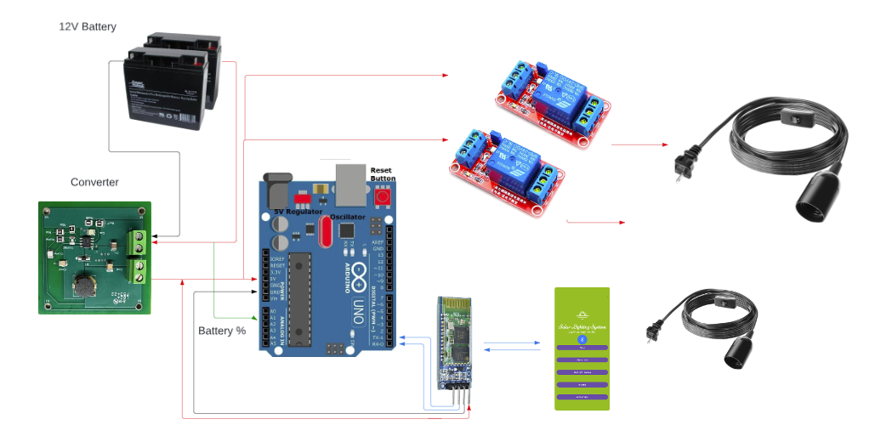
Solar Lighting System Diagram
Notes:
Eric

Slide 4
Project Timeline
Subsystem Designs (completed 01/16) | Subsystems ordered and soldered (2/14) | Integration of Bluetooth and Arduino (3/18) | Integration of Solar Charge Controller and MCU (3/9) | Final Integration (to complete by 3/15) | System Test (to complete by 3/21) | Validation (to complete by 3/25) | Demo and Report (to complete by 4/1)
Notes:
Eric

Slide 5
Solar Charge Controller
Accomplishments since last update 13 hrs of effort | Ongoing progress/problems and plans until the next presentation
Datapoints for battery percentage reading measured. Designed battery terminal block networking. PCB successfully attached to battery, verified full charge functionality. | Print 3D model for enclosure. ON-GOING testing of battery percentage limits. Testing limit needed for Solar Charge Controller to function.

Slide 6

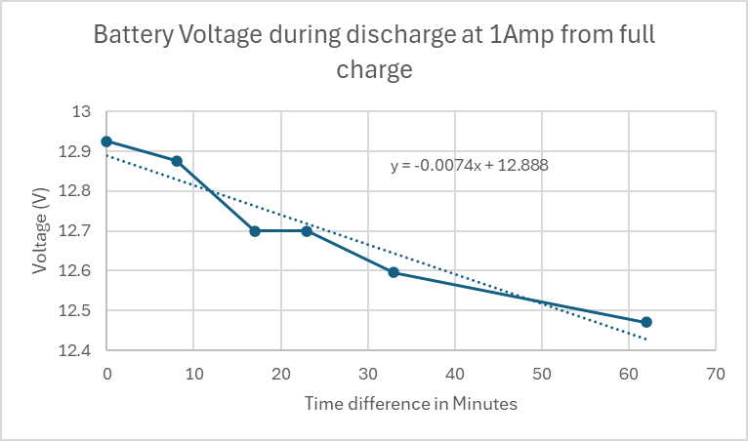
Testing Battery percentage using electronic load set at 1Amp
time diff (m) | Batt1 (V)
0 | 12.925
8 | 12.876
17 | 12.7
23 | 12.7
33 | 12.595
62 | 12.47

Slide 7
Power Subsystem
Jeb Malek
Accomplishments since 403 33 hrs of effort | Ongoing progress/problems and plans until the next presentation
Power transformer voltage invalidated Converter Ordered/Assembled | Converter Validation Attach Arduino, Sensor, Light Loads
Tested Flyback Transformer , Received & Tested Converter

Slide 8
Power Subsytem
Jeb Malek
Verification of Flyback Transformer
Shorting Issue , Testing with Dr. Jang on Variable AC Load, proved does not operate with AC input/output with short circuit test.
Advisor directed to postpone inverter validation and power LED load with purely DC source.

Slide 9
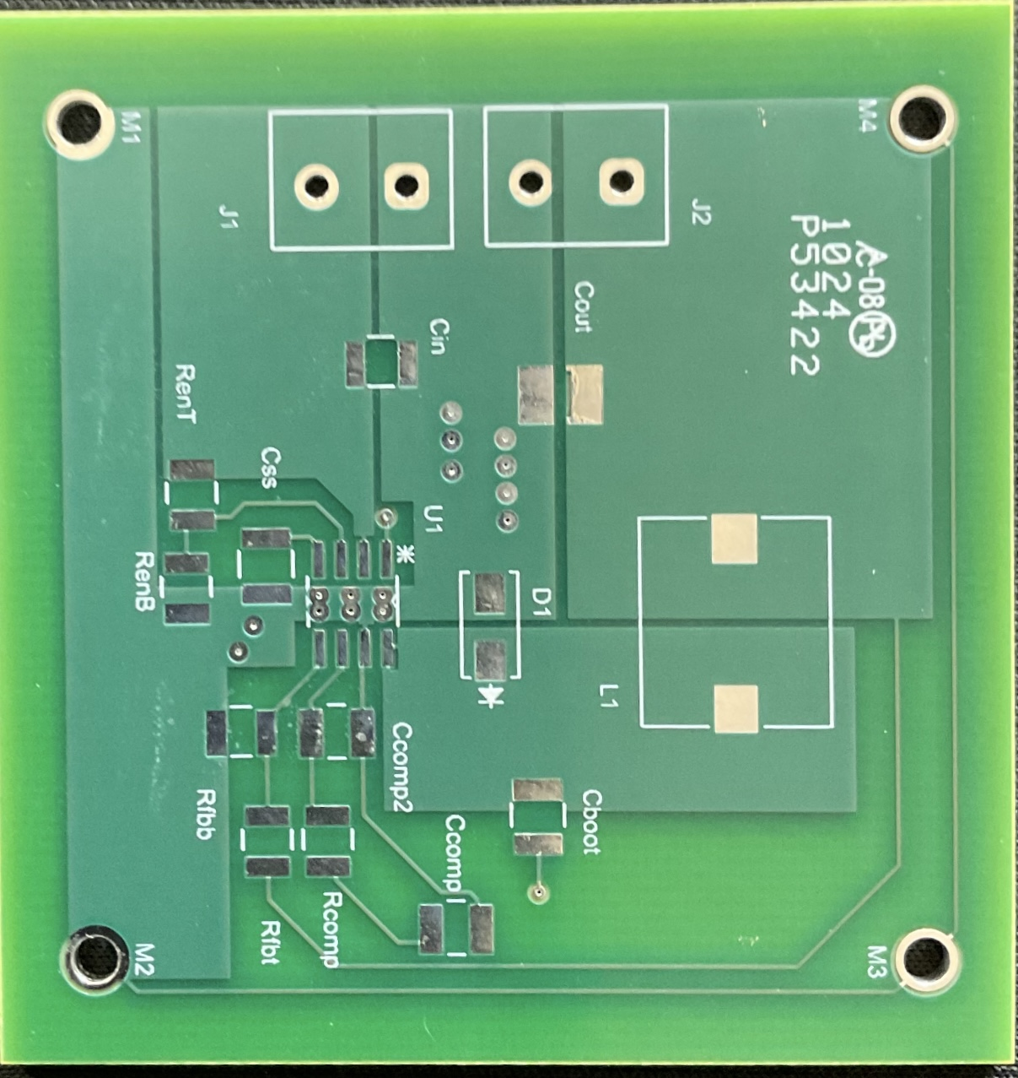
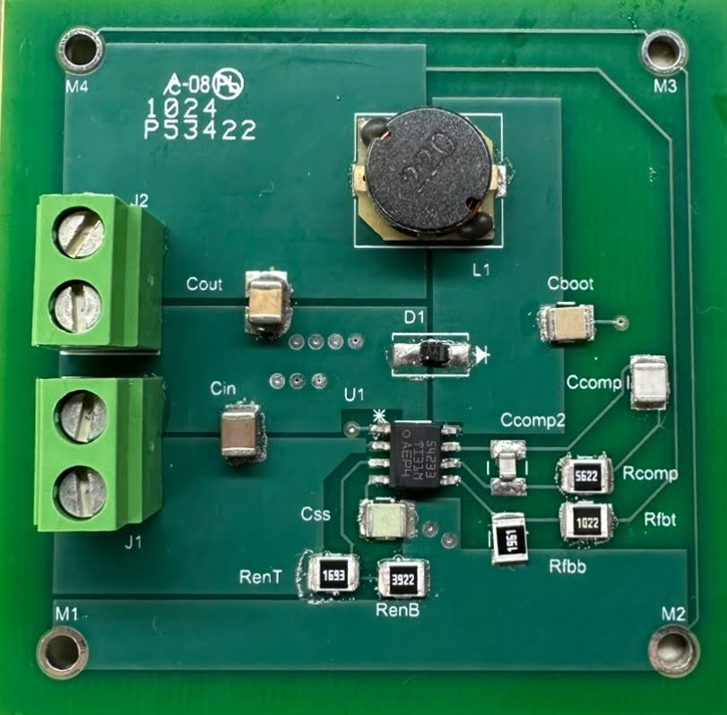
Power Subsytem
Jeb Malek
Converter PCB

Slide 10
Microcontroller Subsystem
Jeb Malek & Josh George
Accomplishments since 403 20 hrs of effort | Ongoing progress/problems and plans until the next presentation
Testing of Controlled Relay Communication with Arduino, and Light Load Testing of Sensor proximity operation switching light load | Enclosure design & 3D Print Synchronization of switch operation and motion sensing and distance sensitivity.
Bluetooth App works to actuate relay control, regardless of motion sense

Slide 11
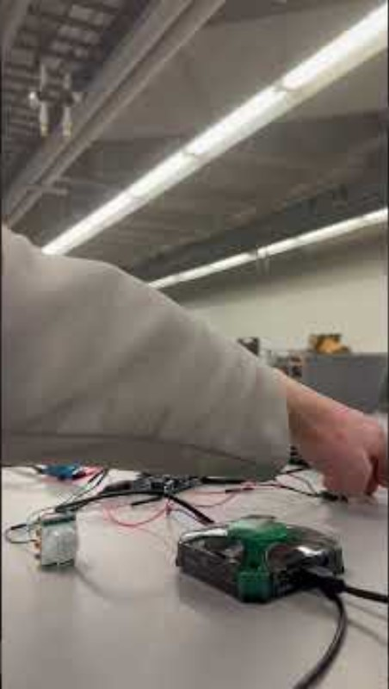
Microcontroller Subsytem
Jeb Malek & Josh George
Motion Sensor Motion and Light Switch Test

Slide 12
Mobile Application
Josh George
Accomplishments since last update 14 hrs of effort | Ongoing progress/problems and plans until the next presentation
-Solved an issue where arduino pins would cross-talk -Modified Bluetooth connectivity to read and drive voltage to pins -New page for graphing -Implemented array scatterplots showing battery percentages | -Implement HC-05 Bluetooth module coming tomorrow -Use values taken from solar charge controller in the graphing fragment

Slide 13
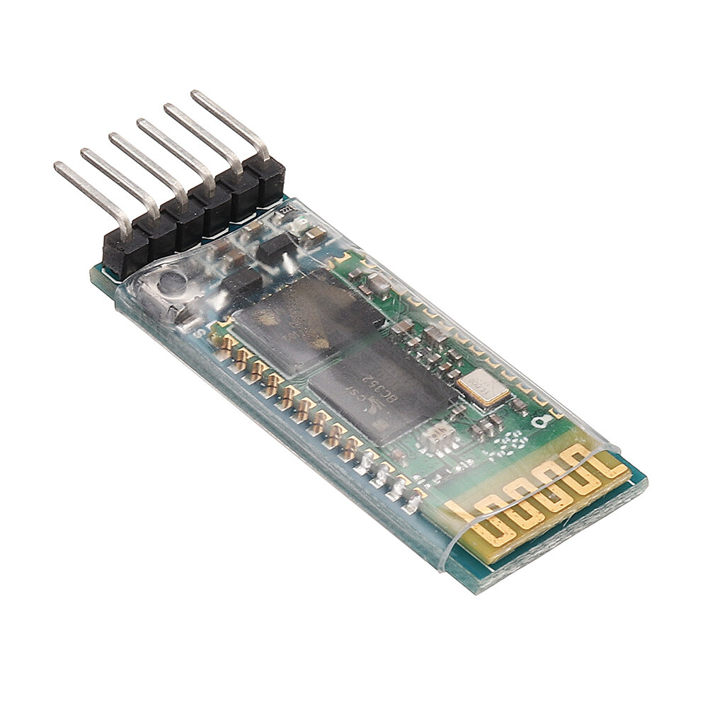
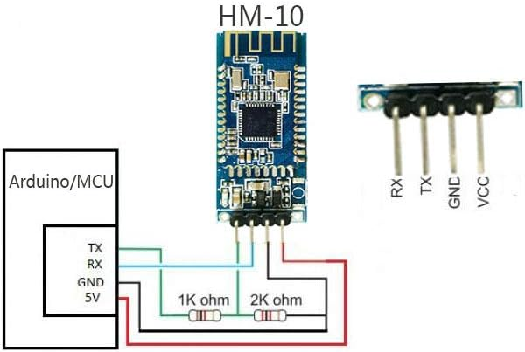
HC-05 Bluetooth Module

Slide 14
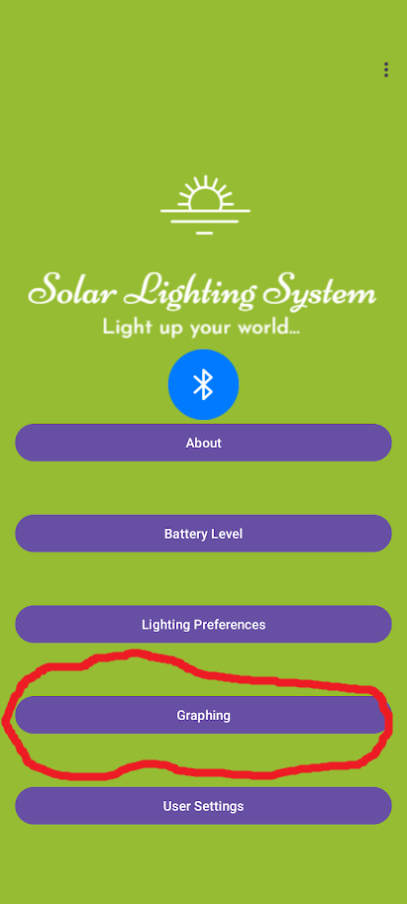
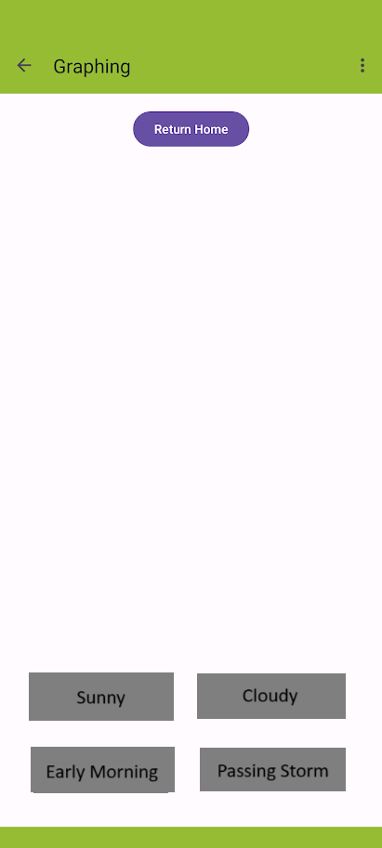
Mobile Application
Josh George

Slide 15
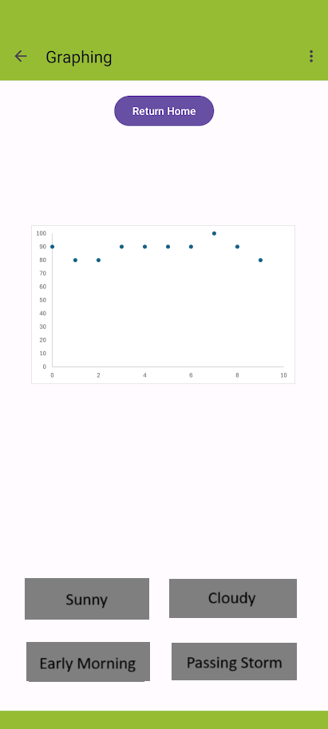
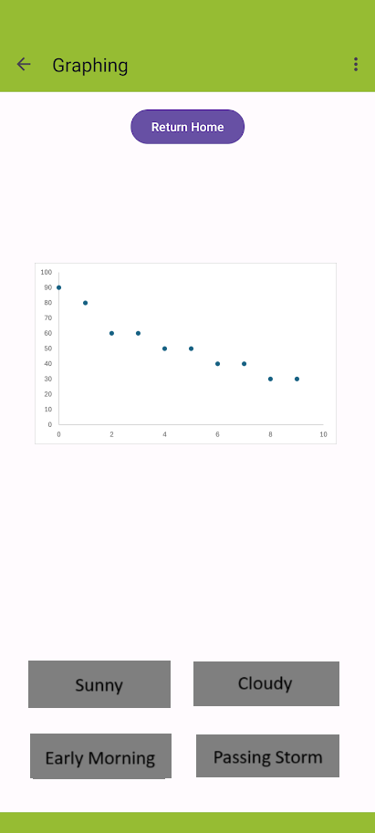
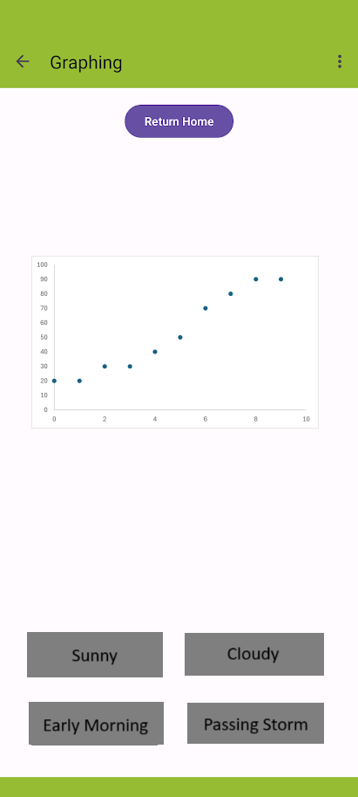
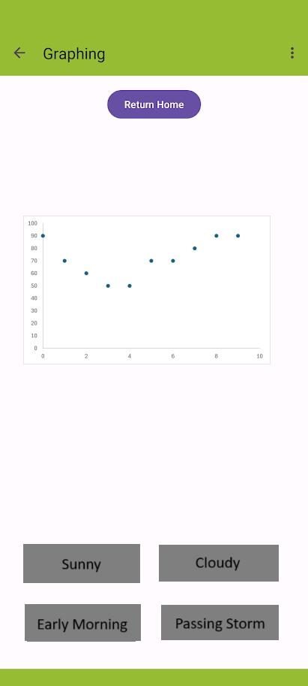




Mobile Application
Josh George

Slide 16
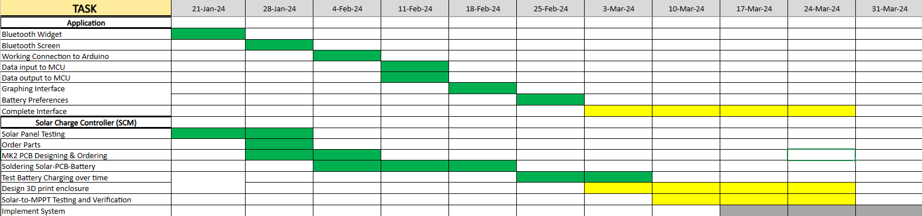
Execution Plan
Notes:
Michelle

Slide 17
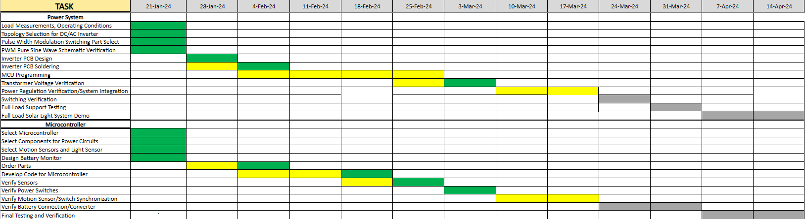
Execution Plan

Slide 18
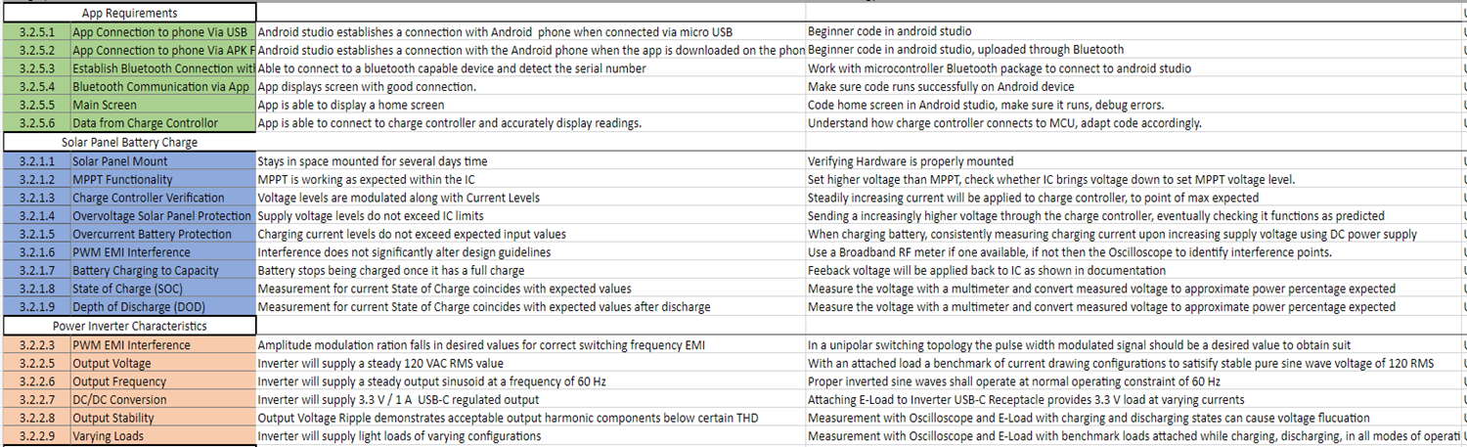
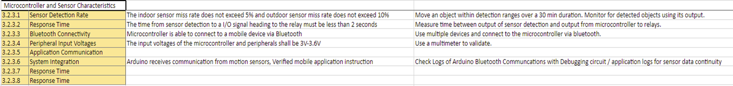
Validation Plan

